Slide 1
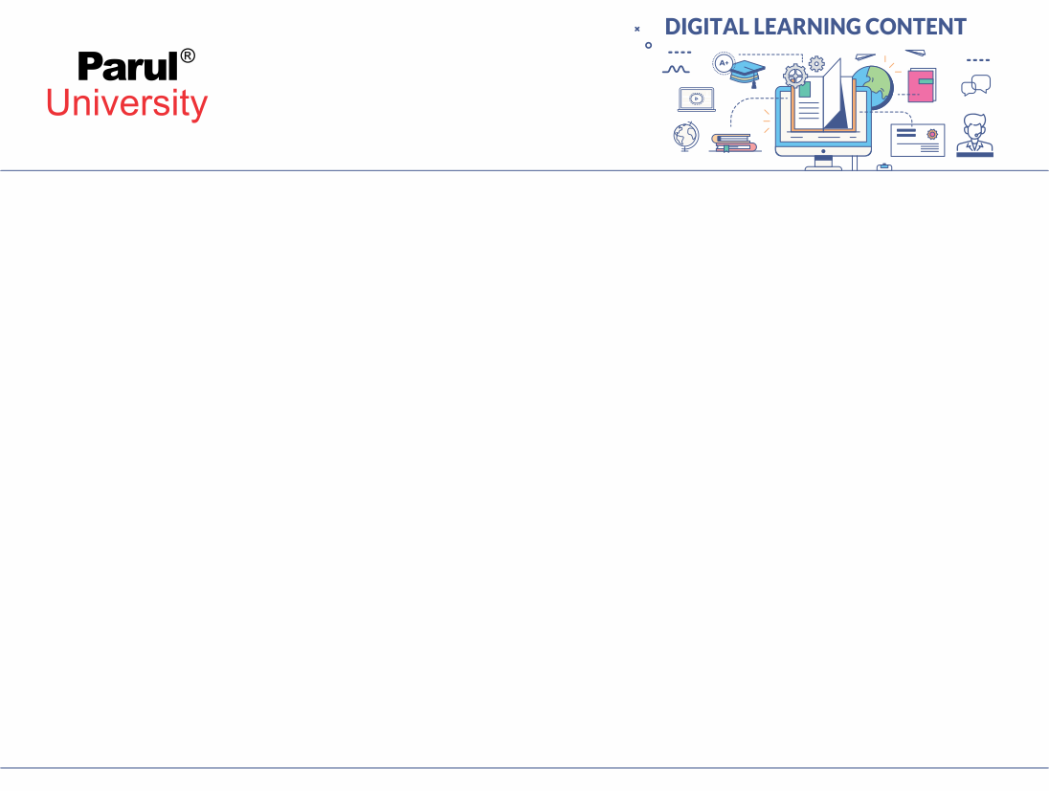

Experiment-1
Write a Program to Understand Concept of Exception Handling in Java.

Slide 2
Aim: Write a Program to Understand Concept of Exception Handling in Java
Objectives:
The Exception Handling in Java is one of the powerful mechanism to handle the runtime errors so that the normal flow of the application can be maintained. an exception is an event that disrupts the normal flow of the program. It is an object which is thrown at runtime.
Advantage :To maintain the normal flow of the application. An exception normally disrupts the normal flow of the application.
Apparatus/Components: jdk installed, laptop/desktop.

Slide 3
Theory/Concepts/Formulas (If Applicable)
To understand exception which can be managed by the following keywords:
try :Program statements which needs to be examined for error should
be contained in the try block.
catch: If an exception occurs using catch it can be handled.
throw: To manually throw an exception, throw is used.
throws: Any exception that is thrown out of a method must be specified
using throws.
finally: The code which is to be executed after try is put in this block.

Slide 4
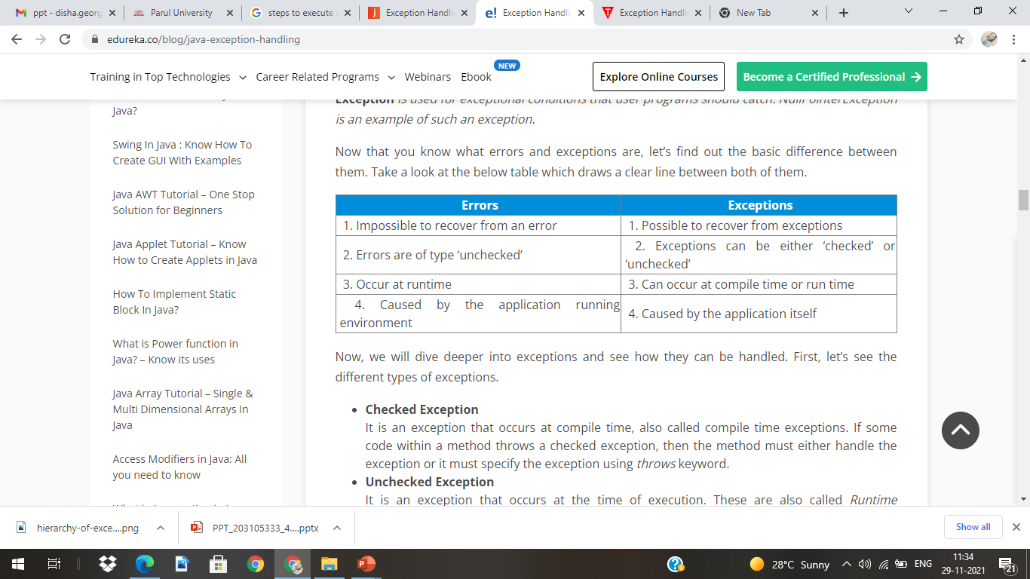
Theory/Concepts/Formulas (If Applicable)

Slide 5
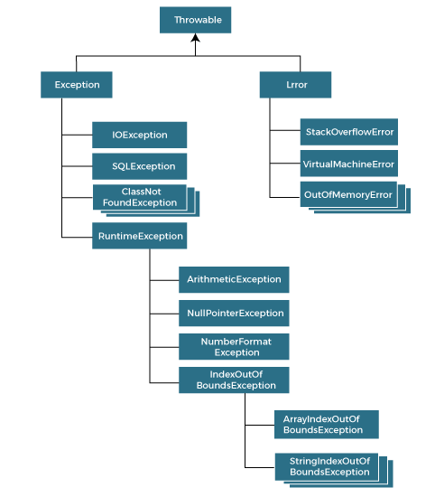
Types of Exceptions:
source: javatpoint.com

Slide 6
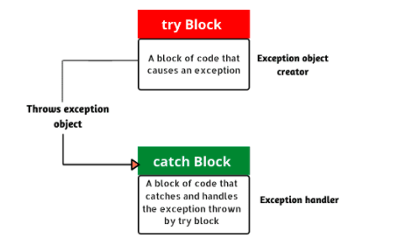
Exception Handling Mechanism

Slide 7
Procedure
Step 1: Open JAVA API
Step 2: Go to file menu and choose new file.
Step 3: To handle the Exception, put the code in the Try block
Step 4: As exception occurs, Try block is skipped.
Step 5: Catch block catches exception and statements inside catch block will execute.
Step 6: Save with .java extension & Debug code from debug menu.
Step 7: Run and Check results

Slide 8
Code / Algorithm /Flow Chart (Any one If applicable)
1) Divide by zero
public class JavaExceptionExample
{
public static void main(String args[])
{
try{
int data=100/0;
}
catch(ArithmeticException e)
{
System.out.println(e);
}
System.out.println("rest of the code...");
}
}

Slide 9
2) Try ,catch and Finally:
Code / Algorithm /Flow Chart (Any oneIf applicable)
class FinallyDemo{
public static void main (String[] args)
{
try{
float y=3.2;}
catch(Exceptione)
{System.out.println(e);} finally{System.out.println(“I will get executed no matter what !!”);}}

Slide 10
3) Custom Exception :
Code / Algorithm /Flow Chart (Any oneIf applicable)
class InvalidAgeException extends Exception
{
public InvalidAgeException (String str)
{
super(str);
}
} public class TestCustomException1
{
static void validate (int age) throws InvalidAgeException{
if(age < 18){
throw new InvalidAgeException("age is not valid to vote");
}
else {
System.out.println("welcome to vote");
}
}

Slide 11
3) Custom Exception :
Code / Algorithm /Flow Chart (Any oneIf applicable)
public static void main(String args[])
{
try
{
// calling the method
validate(13);
}
catch (InvalidAgeException ex)
{
System.out.println("Caught the exception");
System.out.println("Exception occured: " + ex);
}
System.out.println("rest of the code...");
}
}

Slide 12
Experiment Demonstration

Slide 13
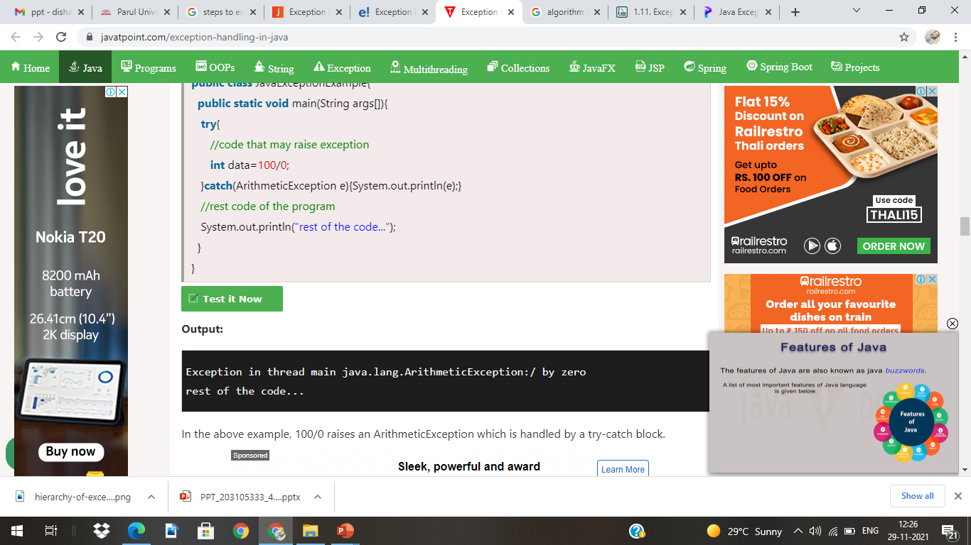

Output
1. Divide by Zero:
2. Using Try Catch & Finally..
Illegal character:’u201c’
I will get executed no matter what !!
3. Custom Exception:

